Slide 1
Section 4.3
Proportional Reasoning

Slide 2
Equivalent Fractions
When two fractions are equal, the ratios between the numerator and denominator are the same
What you multiply on top from one fraction to another is the SAME as
What you multiply on the bottom from one fraction to another
Divide the two numerators
to find out what number to
multiply by

Slide 3
Practice: Given each fraction, determine the missing value:

Slide 4
Proportional Reasoning:
Equivalent fractions can be used in solving problems that involve rates and ratios
  Ie: Scales used in maps for finding distances
  Problems involving speed, time and distance
  Finding population size
  Lengths of similar objects
Ex: The scale on a map is 1 to 8000. If the distance between two places on a map is 25cm, how far are they apart?
The two places are 200,000cm apart
Which is 2km apart
Map:
Real:

Slide 5
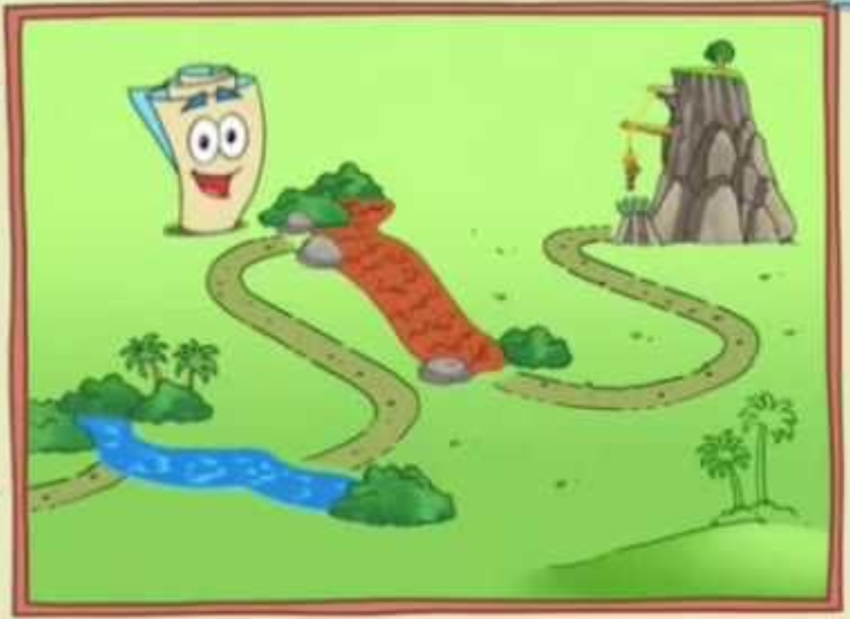


Diego’s gf is in trouble and he needs to go save her. The scale on the map is 1:750,000 and is 25cm apart on the map. How far does Deigo have to travel to reach her?

Slide 6
Practice: The ratios of boys to girls in a classroom is 4:5. If there are 28 boys, how many girls are there?
There are 35 girls in the classroom
Boys:
Girls:
Tim can run 25meters in 5 seconds. If he runs at a constant speed, how far can he run in 80seconds?
Distance:
Time:
Tim can run 400m in
80 seconds

Slide 7
Sampling: Capture-Mark-Recapture
This method is often used when counting is difficult
  The population of fish in a lake
Someone will first capture an amount of a species, mark them and then release them
Sometime later, they will recapture another batch and count how many of them are marked
Using concepts of ratios, you can calculate an estimate of the population
© Copyright all rights reserved to Homework depot: www.BCMath.ca

Slide 8






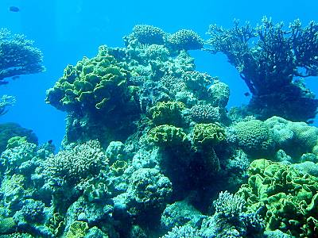


When the population is moving
this fast, it’s difficult to count.
Instead, we use a sampling method of
“Capture-Mark-Recapture”
We will then capture some fish again
and check how many are marked.
The percentage of fish marked will
help determine the population
Capture some fish and then mark
them. (about 100 fish)Then release
the fish back into the water
© Copyright all rights reserved to Homework depot: www.BCMath.ca

Slide 9

Ex: Suppose 150 fish were captured and marked during the first catch. Few days later, another 150 were captured and 25 of them had the mark. What is the population of the fish?
Let “x” be the total population
There is approximately 900 fish in the lake
© Copyright all rights reserved to Homework depot: www.BCMath.ca

Slide 10
Practice: A survey was done to determine the crab population in the Fraser River. On the first catch, 300 crabs were marked and released. On the second catch, 250 were caught and only 17 had the mark. What is the total population?
Let “x” be the total population
Divide 300 by 17 to find what number
to multiply the fraction with
There is approximately 4412 crabs in the river
© Copyright all rights reserved to Homework depot: www.BCMath.ca

